Slide 1
Operating System Fundamentals
Computer Engineering
Notes:
Introduction to the presentation on Operating System Fundamentals.

Slide 2
Introduction to Operating Systems
Operating systems manage computer hardware and software resources efficiently and effectively always.
OS acts as an intermediary between computer hardware and user-level applications seamlessly.
Operating systems provide a platform for running applications and services securely.
They control and coordinate hardware components like CPU, memory, and storage devices.
OS manages memory allocation, deallocation, and fragmentation to optimize performance always.
It provides a file system for storing, retrieving, and managing files and directories.
Operating systems handle input/output operations between devices and applications smoothly.
They ensure security, integrity, and authentication of data and users through access control.
OS enables multitasking, multithreading, and multiprocessing to increase system productivity.
Notes:
Present Introduction to Operating Systems in the context of Operating System Fundamentals.

Slide 3
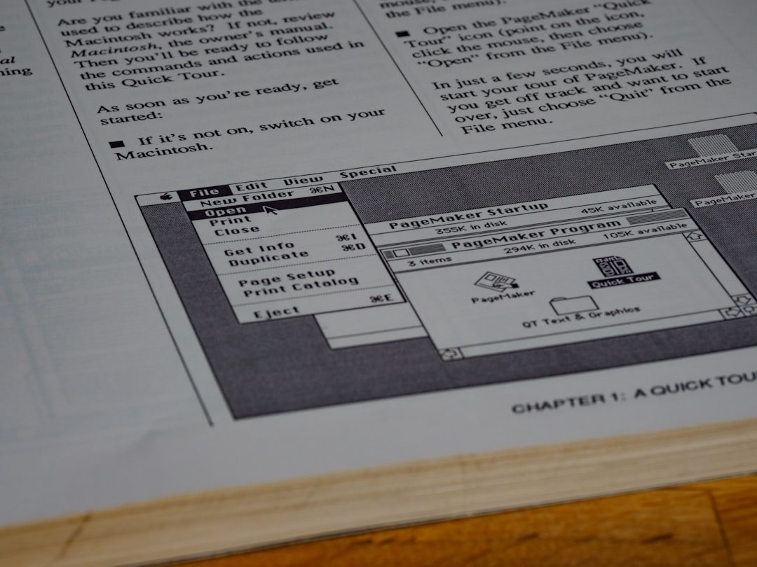
Process Management Concepts
A process is a program in execution with its own memory space.
Process scheduling determines which process runs at a given time.
Notes:
Present Process Management Concepts in the context of Operating System Fundamentals.

Slide 4
Memory Management Techniques
Paging technique divides memory into fixed-size blocks for efficient allocation and deallocation purposes.
Segmentation method organizes memory into variable-size blocks for better memory utilization rates achieved.
Virtual memory combines physical and secondary storage for increased memory capacity and flexibility offered.
Memory mapping enables programs to access shared libraries and memory regions efficiently and securely.
Swapping technique involves exchanging pages of memory between main and secondary storage devices quickly.
Cache memory provides fast access to frequently used data and instructions for improved performance.
Memory protection mechanisms prevent unauthorized access to memory regions and data corruption occurrences.
Dynamic memory allocation allows programs to request and release memory as needed during execution time.
Memory compaction reduces memory fragmentation by rearranging free memory blocks into contiguous areas.
Notes:
Present Memory Management Techniques in the context of Operating System Fundamentals.

